Slide 1
TABULAR DATA

Slide 2

Spreadsheets and databases rule the world!
Ariel Fischman holds the Guinness World Record for owning the most spreadsheet software (over 500!)
https://techcommunity.microsoft.com/t5/excel-blog/guinness-world-records-the-largest-collection-of-spreadsheet/ba-p/216592

Slide 3
What is tabular data?
What is it? columns have different types, rows can have a meaningful index
Date (index) | Wind speed | Wind direction | Rain fall (mm) | Hours of sun
7.3.2024 | 7.1 | N | 0.0 | 10
8.3.2024 | 0.3 | NW | 2.1 | 2
9.3.2024 | 1.1 | SE | 0.3 | 5
Subject ID (index) | Condition ID | Presentation nr | Response time (ms) | Response
VM | 732 | 2 | 28 | LEFT
VM | 732 | 3 | 41 | RIGHT
PB | 665 | 1 | 73 | LEFT

Slide 4
Many tools to handle tabular data
Python tools
pandas: in-memory tabular data
dask: on-disk tabular data
SQL databases
Optimized for retrieving rows (tree data structure for index)
Transactional: groups of operations are either all executed, or none
Columnar DBs, Spark, Hadoop
Optimized for operations on columns
Ideal for data science tasks
Operations can be automatically distributed over multiple machines

Slide 5
Tabular data ideas and operations are universal for all tabular data tools
Pandas
df.groupby(‘condition_id’)[‘response_time’].mean()
dask
df.groupby(‘condition_id’)[‘response_time’].mean()
PySpark
df.groupby(‘condition_id’).avg(‘response_time’)
SQL
SELECT condition_id,
AVG(response_time) AS avg_response_time
FROM df
GROUP BY condition_id;

Slide 6

Introduction to Pandas
Live Coding
notebooks/tabular_data/ 010_pandas_introduction.ipynb

Slide 7
Introduction to Pandas
Live Coding
notebooks/tabular_data/ 010_pandas_introduction.ipynb
Main points:
A DataFrame is a tabular data structure
DataFrames have labeled columns and rows (“indices”)
Columns can be of different native dtypes
Operations are on columns by default
NaNs are interpreted as missing data and ignored in most operations
Strings (and dates) have a special accessor to perform vectorized string (or date) operations

Slide 8
NEED REFERENCE SLIDE
Summary of basic Pandas operations
TODO

Slide 9

Tabular data example from the lab
Research question: Does neuronal activity change over time? Does this depend on the overall activity level of the neuronal network? The mainstream theory suggests that neural activity is self-regulating to maintain a baseline level
Exp design: patch clamp recordings from the same cells (or different cells/ same slices) before and after prolonged incubation in high potassium (K)
Potassium stimulates the entire network, so that we can control the overall activity

Slide 10
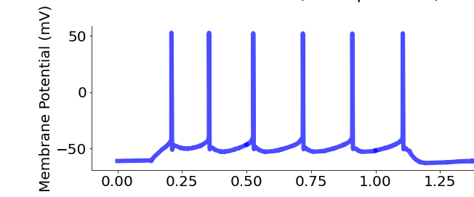
Variables
Applied Current
300 pA
Day 1 (D1)

Slide 11
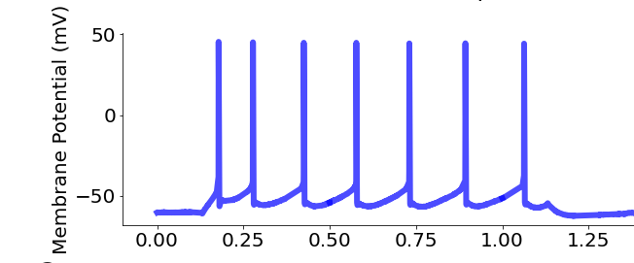
Variables
Applied Current
300 pA
Day 1 (D1)
Day 2 (D2)

Slide 12
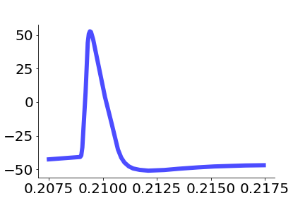
Variables
D1
mV
D2
Time (seconds)

Slide 13
Variables
Action potential (AP) properties
D1
resting_potential = -74.3 mV
* *. *. * * *
max_spikes = 6
max_repol =
-91.4 mV/ms
AP_heigth
= 92.2 mV
mV
AP_halfwidth
= 0.91 ms
D2
max_depol =
377.4 mV/ms
TH =
-39 mV
Time (seconds)
Time (seconds)

Slide 14

Hands-on Have a look at the electrophysiology data
Exercise
exercises/pandas_intro
Submit a PR for Issue #? on GitHub

Slide 15
TABULAR DATA OPERATIONS

Slide 16
Common operations on tabular data
Tabular data has additional needs compared to arrays. Understanding how to vectorize these operations is critical for handling them
Combine information across tables (join, anti-join)
Join: e.g., combine table with experiments results with table with experiments metadata (date, location, experimenter, free-form notes, …)
Anti-join: e.g. student compiles list of outliers, exclude them from the table of experiments to analyze
Summary tables (split-apply-combine):
E.g., compute average measurement and standard deviation by experimental condition and treatment dosage
Window functions

Slide 17
Joins

Slide 18
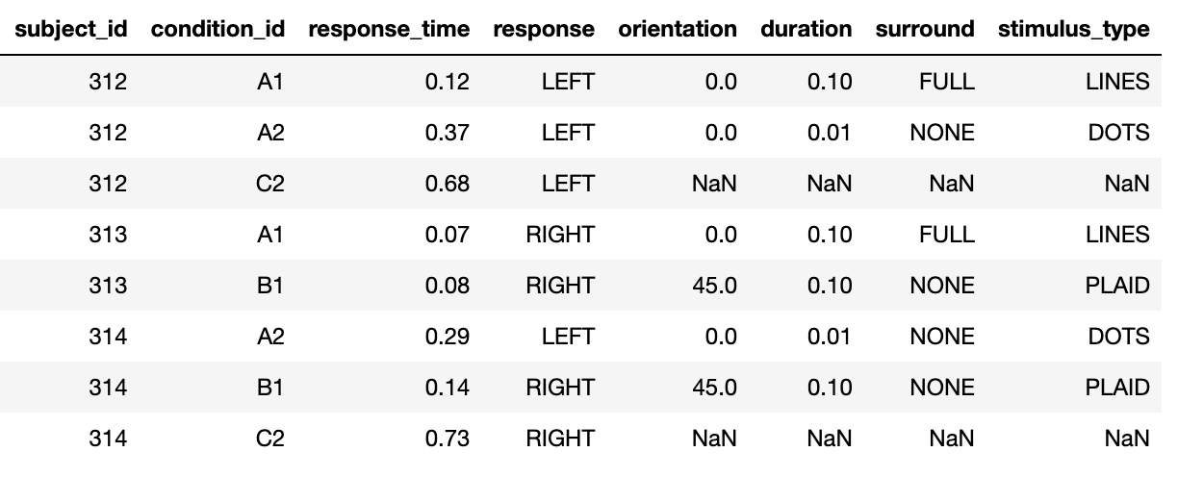
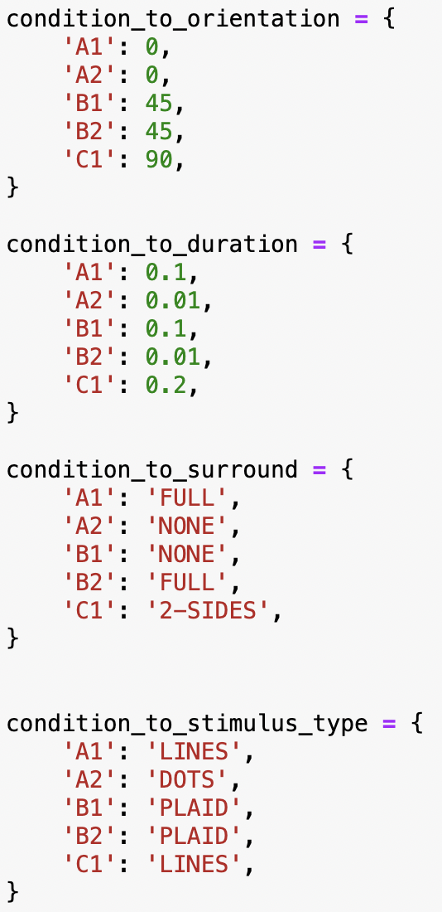
Join operations: combining informations on separate tables
+
=

Slide 19
Join operations
Live Coding
notebooks/tabular_data/
020_join_operations.ipynb
Main points:
Join operations can be used to combine two tables using the values of one or more columns
Different types of join:
left/right: keep all the column values that are present in the first/second table
inner: keep all the column values that are present in both tables
outer: keep all the column values that are present in one or the other tables
Anti-joins can be used to exclude the values that are present in one, but not the other table (filtering based on arbitrary criteria)

Slide 20
Hands-on
Exercise
exercises/tabular_join
Merge data from electrophysiology experiment with metadata, by experiment ID and area(?)
Exclude list of outliers
Submit a PR for Issue #? on GitHub
clean up this slide

Slide 21
Split-apply-combine

Slide 22
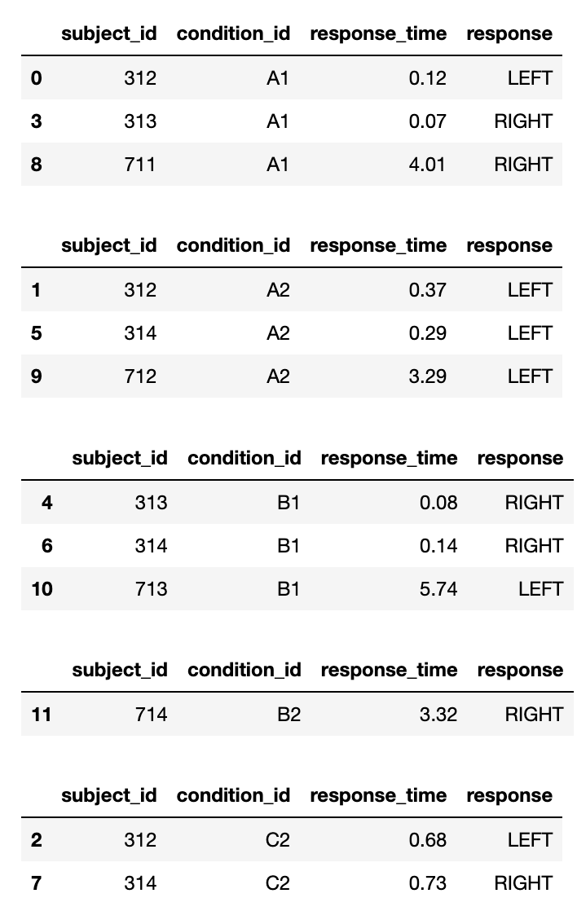
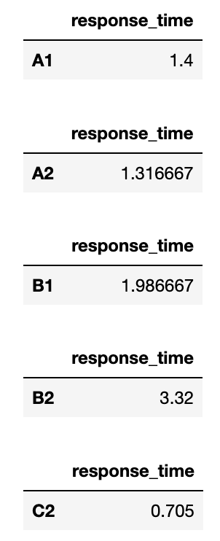
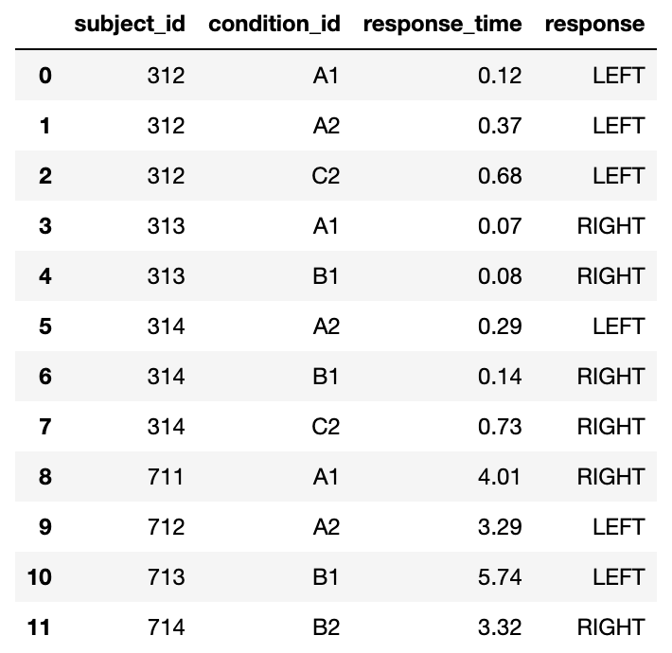
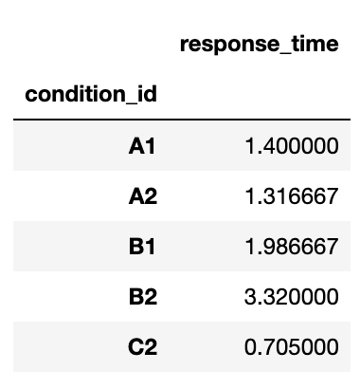
The basic structure of most numerical analyses
split
apply
combine
A1
A2
mean
B1
B2
C2

Slide 23
Split-apply-combine operations
Live Coding
notebooks/tabular_data/
030_split-apply-combine.ipynb
Main points:
Tabular data tools have a way to vectorize the standard split-apply-combine operations, using a “group-by” command
In addition, Pandas has got a “pivot-table” command that can be used to simplify the creation of more complex summary tables

Slide 24
df.groupby(‘condition_id’)[‘response_time’].mean()
split
apply
combine
A1
A2
mean
B1
B2
C2

Slide 25
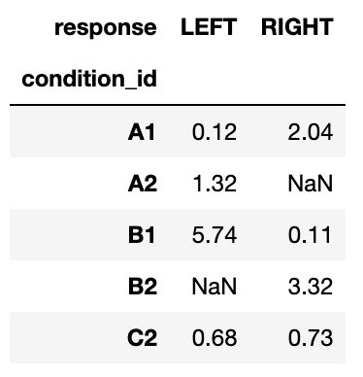
data.pivot_table( index='condition_id', columns='response', values='response_time', aggfunc='mean',
)
split
apply
combine

Slide 26
Hands-on
Exercise
exercises/ tabular_split_apply_combine
Get merge data from previous exercise, group by ….
Submit a PR for Issue #? on GitHub
Need to check with VM that it makes sense

Slide 27
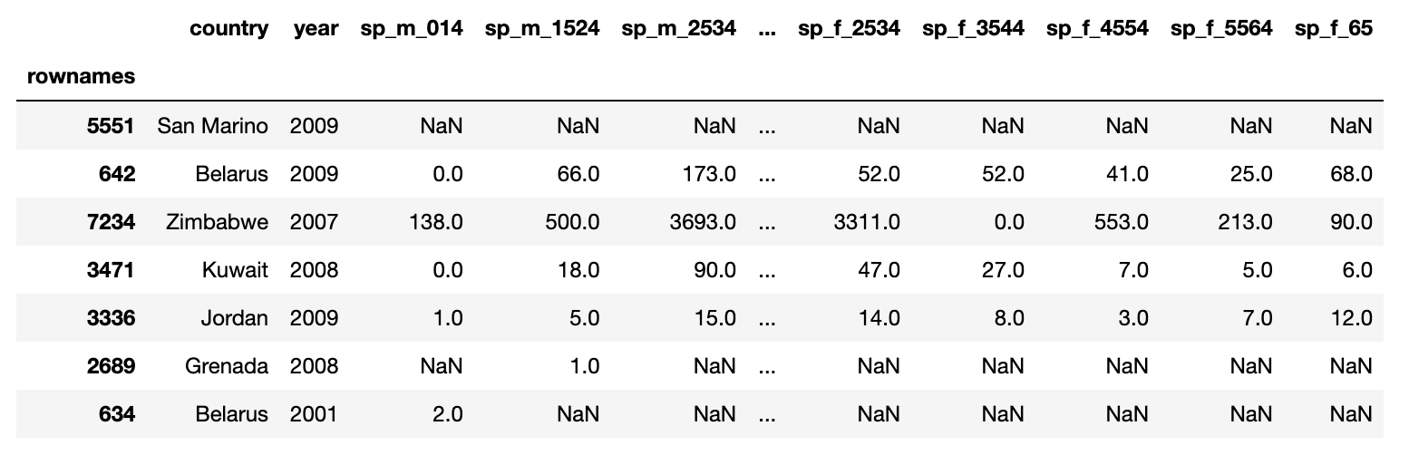
Hands-on
Exercise
exercises/tabular_tidy_date
Submit a PR for Issue #? on GitHub
Males
15-24 years

Slide 28


TIDY DATA

Slide 29
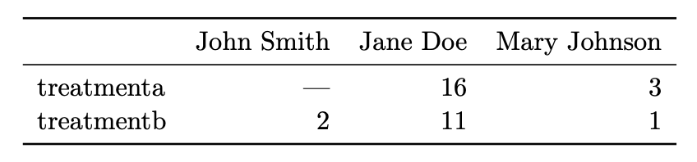
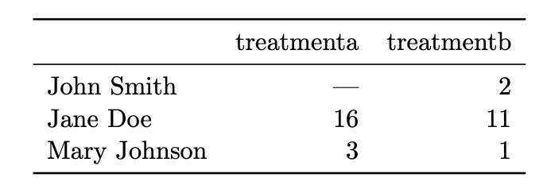
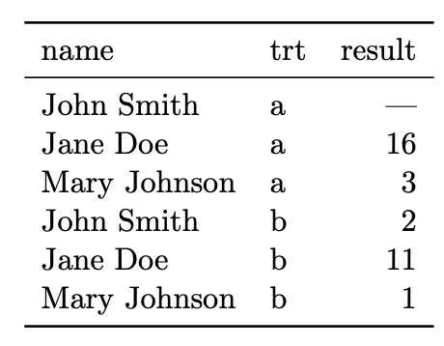
Same data, different organizations Which one is best for data analysis?
The value of the treatment variable is in the column/row name. Imagine wanting to compute the mean over treatment type
imagine adding a new measurements, e.g. accuracy

Slide 30
Same data, different organizations Which one is best for data analysis?
What do we want?
We want data to be in a natural format, such that data analysis is easy

Slide 31
Tidy data
In tidy data:
1. Each variable forms a column 2. Each observation forms a row 3. Each type of observational unit forms a table
Variables (or features, attributes)
Variables increase when new types of measurements are introduced
Subject ID | Condition ID | Trial nr | Response time (ms) | Response
VM | 732 | 2 | 28 | LEFT
VM | 732 | 3 | 41 | RIGHT
PB | 665 | 1 | 73 | LEFT
Observations (or samples)
Observations increase when new units (dates, subjects, …) are measured

Slide 32
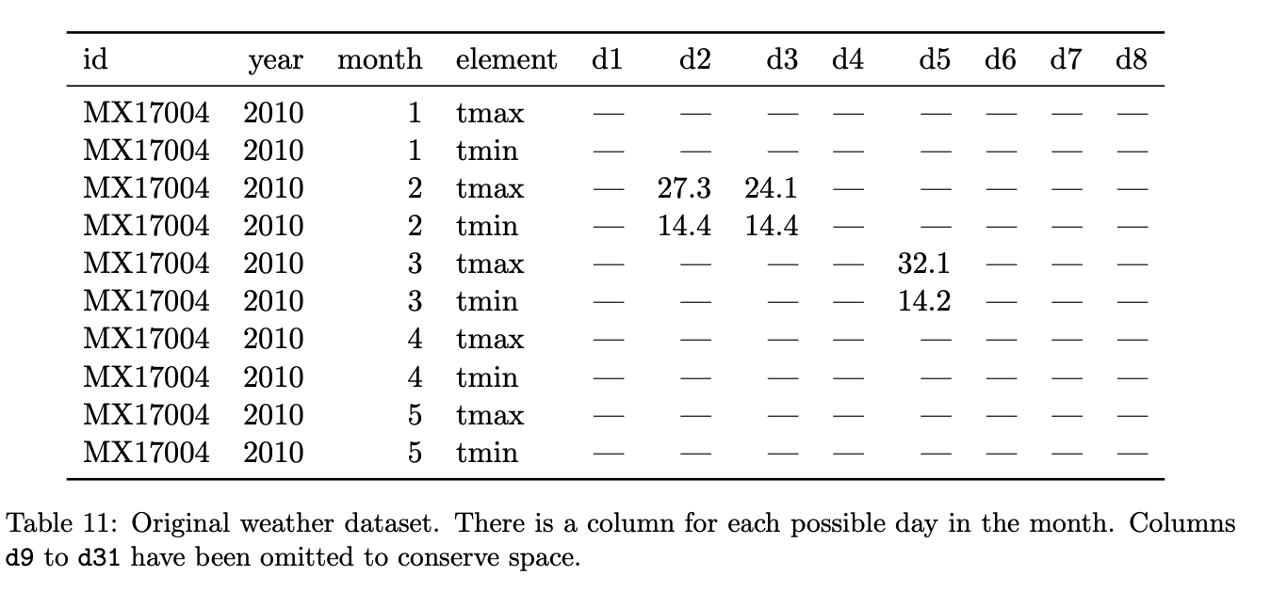
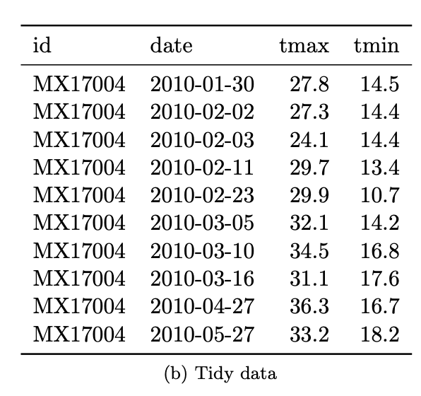
Hands-on
Exercise
Identify variables, observations, and values. What would a tidy version look like?
notice the structural NaNs for months with less than 31 days

Slide 33
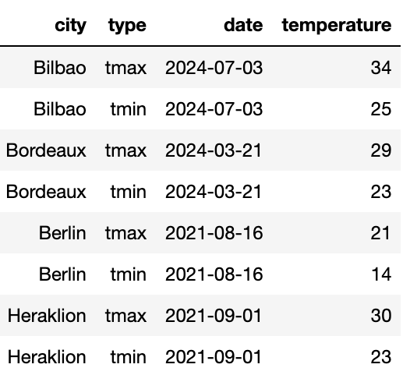
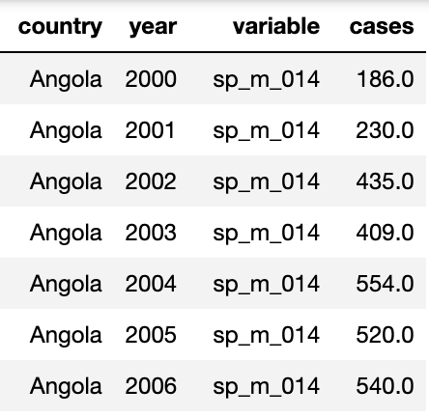
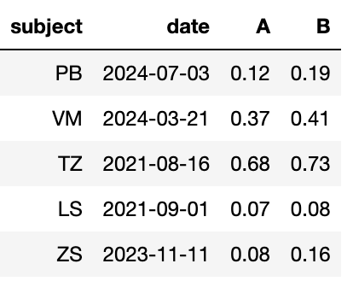
Messy data
“Tidy datasets are all alike but every messy dataset is messy in its own way” – Hadley Wickham
Variables are stored in both rows and columns
Some variables are stored in the file names
😱
😱
2024-01_prices_DE.csv 2024-01_prices_FR.csv 2024-02_prices_DE.csv 2024-02_prices_FR.csv
Multiple variables are stored in one column
Column headers are values, not variable names
😱
😱

Slide 34

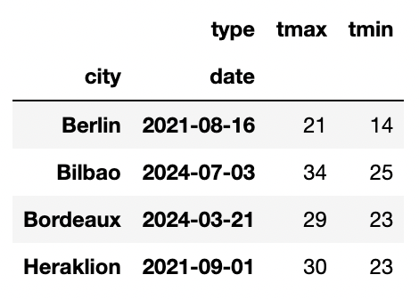
The life-changing magic of tidying up data
Pivoting – we know this one
The “type” column is storing variable names
😱
pivot
df.pivot_table( index=['city', 'date'], columns='type’, values='temperature', aggfunc='max’,
)

Slide 35

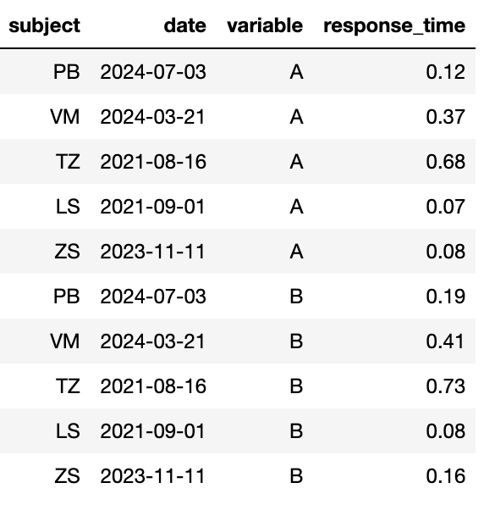
The life-changing magic of tidying up data
Melting – it’s kind of the opposite of pivoting
The treatment values are stored as a column name
😱
melt
pd.melt(data, id_vars=['subject', 'date'], value_name='response_time')

Slide 36

The life-changing magic of tidying up data
pd.concat – add together tables with the same variables
Some variables are stored in the file names
tables = []
for filename in filenames:
# Parse filename
year_month, _, country = filename[:-4].split('_')
# Read table and add columns for the variables
df = pd.read_csv(filename)
df['year_month'] = year_month
df['country’] = country
# Store table
tables.append(df)
# Create complete table
tidy_df = pd.concat(tables)
😱
2024-01_prices_DE.csv 2024-01_prices_FR.csv 2024-02_prices_DE.csv 2024-02_prices_FR.csv

Slide 37
Hands-on
Exercise
Tidy up the data set in exercise #?, and re-compute the summary stats
Multiple variables are stored in one column
😱

Slide 38
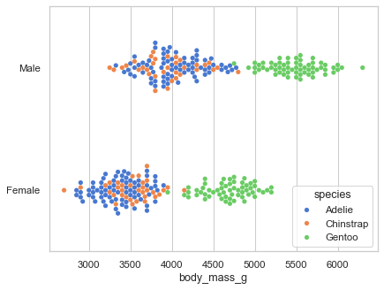
Why is tidy data good?
Many analyses require a simple sequence of steps:
Filter by individual variables to discard data that is not needed
Group and summarize
Re-arrange (e.g. sort)
Visualize
Joining tidy tables is easy!
One can write generic code that takes tidy data as input. For example, seaborn relies on tidy data to make complex plots
sns.swarmplot(
data=df,
x="body_mass_g",
y="sex",
hue="species”,
)

Slide 39
Advanced: window functions

Slide 40
Dealing with changes in the data
Recommendations:
NEVER overwite a data file. Treat data files as immutable
Use versioning for changes in the data file, and load the latest version for new analyses, old versions to reproduce previous results
(pond is a library I’m working on to automatize this process)
Like in computer code:
Adding new columns / rows is generally ok
Deleting/changing a column is not! Code will break! Add a new column instead

Slide 41
Summary
high-level concepts that we learned

Slide 42
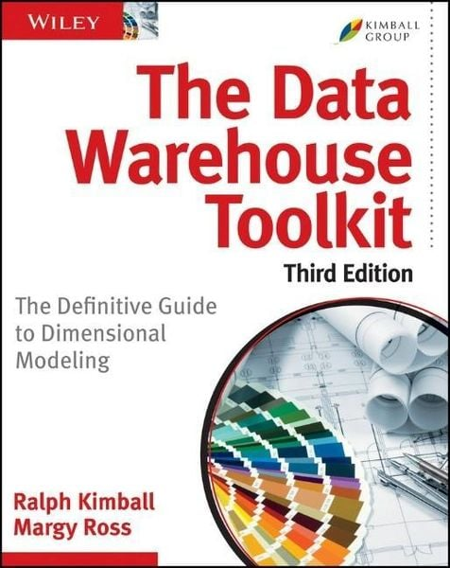
What we didn’t talk about
Other data structures: graphs, trees, priority queues, …
Options for working with large data on disk / remotely (instead of in-memory)
Advanced tabular data operations: window functions
Best practices in data handling: versioning, lineage, sharing
Organizing a complex data set in multiple tables

Slide 43
Thank you!

Slide 45
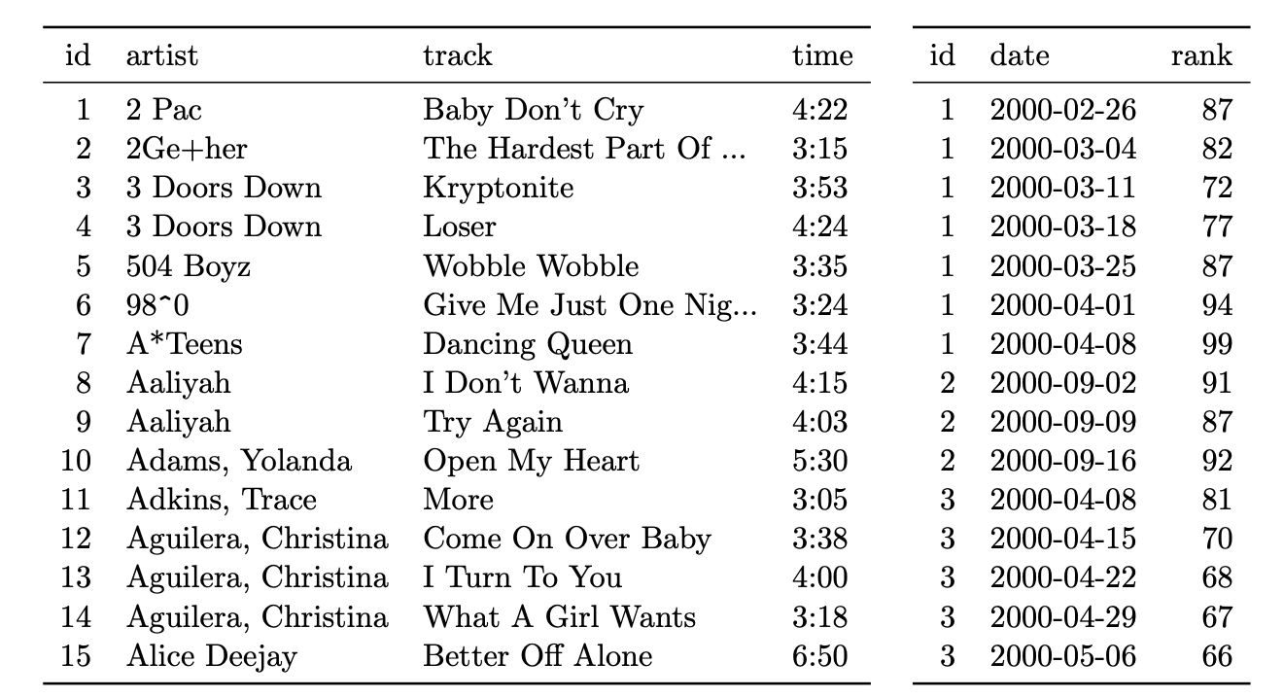
Organizing multiple tables
Dimension vs fact tables
De-normalization (but for data analys flat tables are more convienent)

Slide 46
Data organization
Data organization concepts:
tidy data
normalized data (star organization)
data science friendly data (denormalized)

Slide 47
Tidy data
“Tidy datasets are all alike but every messy dataset is messy in its own way” – Hadley Wickham
Let’s talk about data organization: what does “clean” data look like?
We want data to be in a natural format, where data analysis is easy
Let’s look at what tidy data looks like, then why it’s better that way

Slide 48
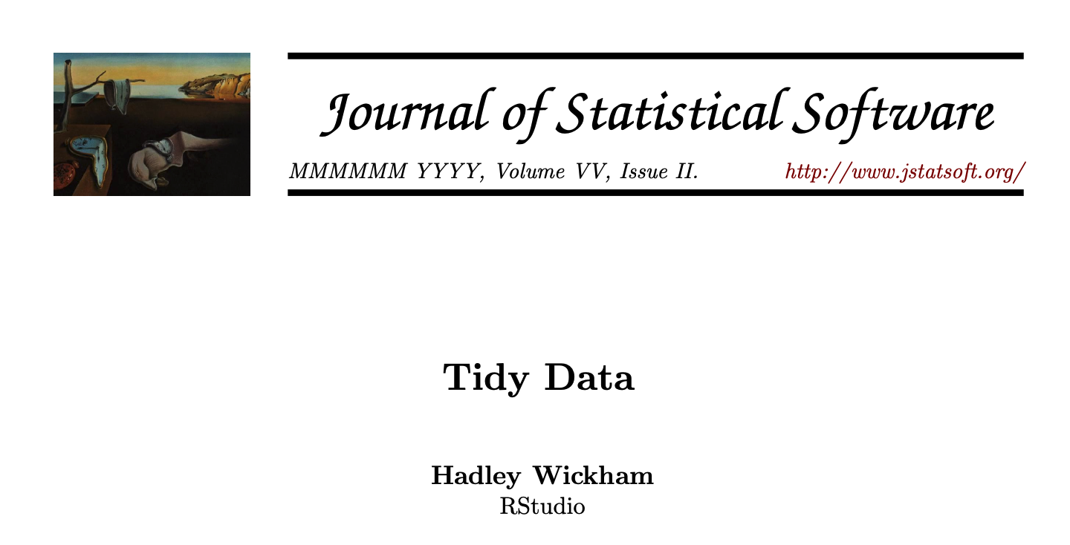
Tidy data
In a given analysis, there may be multiple levels of observation. For example, in a trial of new allergy medication we might have three observational types: demographic data collected from each person (age, sex, race), medical data collected from each person on each day (number of sneezes, redness of eyes), and meterological data collected on each day (temperature, pollen count).

